Slide 1
Tuples in Python

Slide 2
A tuple is an ordered sequence of elements of different data types, such as integer, float, string, list or even a tuple.
In someways a tuple is similar to a list in terms of indexing, nested objects and repetition but a tuple is immutable unlike lists which are mutable.
e = () // empty tuple
x = (1, 2, 3) tuple with integer values
print(x)
y_tuple = (1, "Hello", 3.4) Mixed values
print(y_tuple)
tup1 = ("mouse", [8, 4, 6], (1, 2, 3)) Nested
print(tup1)

Slide 3
A tuple can also be created without using parentheses. This is known as tuple packing.
my_tuple = 3, 4.6, "dog"
print(my_tuple)
tuple unpacking is also possible
a, b, c = my_tuple
print(a) # 3
print(b) # 4.6
print(c) # dog

Slide 4
Creating tuples from existing sequences
t=tuple(<sequence>)
where <sequence> can be any kind of sequence object including string , list and tuples.
t1=tuple(‘computer’)
print(t)
Output:
(‘c’, ‘o’, ‘m’, ‘p’, ‘u’, ‘t’, ‘e’, ‘r’)

Slide 5
some of the main advantages:
• We generally use tuple for heterogeneous (different) data types and list for homogeneous (similar) datatypes.
• Since tuple are immutable, iterating through tuple is faster than with list. So there is a slight performance boost.
• Tuples that contain immutable elements can be used as key for a dictionary. With list, this is not possible.
• If you have data that doesn’t change, implementing it as tuple will guarantee that it remains write-protected.
• We can use the index operator [] to access an item in a tuple, where the index starts from 0.

Slide 6
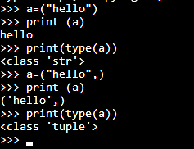

Slide 7
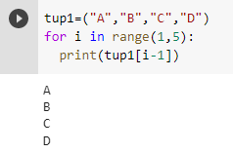
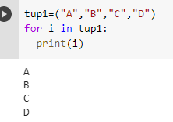
Accessing Tuple elements

Slide 8
Tuple Functions and Methods
The len() method – It returns length of the tuple, i.e. ,the count of elements
in the tuple.Ex:
>>>tp=(1,2,3)
>>>len(tp)
3
The max() method – It returns the element from the tuple having
maximum value.Ex:
>>>tp=(10,5,78)
>>>max(tp)
78

Slide 9
The min() method – It returns the element from the tuple having minimum
value. Ex:
>>>tp =(9,3,1)
>>>min(tp)
1
The index() method – It returns the index of an existing element of a
tuple.Ex:
>>>t1=(3,4,5,6)
>>>t1.index(5)
2

Slide 10
The count() function – This method returns the count of a member element in a given tuple. Ex:
>>>t1=(2,3,4,5,6,2,7,8,2)
>>>t1.count(2)
3
The tuple() method – It is constructor that can be used to create tuples
from different types of values.
>>>t= tuple(“abc”)
>>>t
(‘a’, ‘b’, ‘c’)

Slide 11
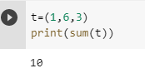
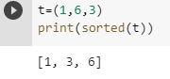
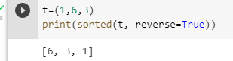
Sum()
This function returns the sum of the elements of a tuple.
Sorted()
The function is used to sort the elements of a tuple

Slide 12
Tuple Operations :
Joining Tuple – The + operator, when used with two tuples, joins two
tuples.Ex:
>>>t1=(1,2,3)
>>>t2=(4,5)
>>>t1 + t2
(1,2,3,4,5)

Slide 13
Replicating Tuple – The * operator is used to replicate a tuple specified
number of times.Ex:
>>>t1=(1,2)
>>>t1*2
1212
Slicing the tuple – It gives a sub part of the tuple like list and string

Slide 14
Deleting a Tuple
we cannot change the elements in a tuple. That also means we cannot delete or remove items from a tuple. But deleting a tuple entirely is possible using the keyword del.
n=(1,2,3,4,5)
print(n)
del n[1]
output:
error : TypeError: ‘tuple’ object doesn’t support item deletion

Slide 15
n=(1,2,3,4,5)
print(n)
del n
print(n)
output:
(1, 2, 3, 4, 5)
# NameError: name ‘n’ is not defined

Slide 16
Comparing tuples
We can compare two tuples using the comparison operators i.e. <, >, <=, >=, == and !=. Python internally compares individual elements of two tuples.
Example:
a=(1,2)
b=(1,2)
print(a==b)
print(a>b)
print(a<b)
output:
True
False
False

Slide 17
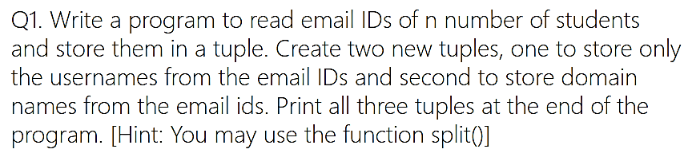

Slide 18
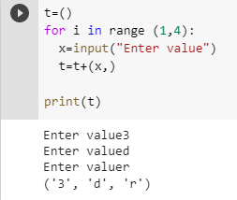

Slide 19
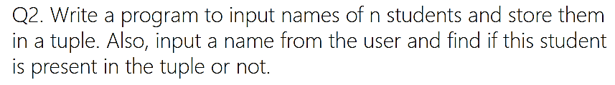

Slide 20
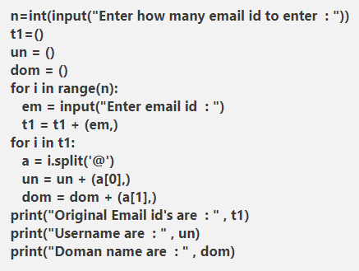

Slide 21
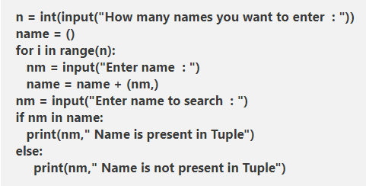

Slide 22
Write a Python program to convert a tuple of string values to a tuple of integer values.
Write a Python program to find repeated items in a tuple.

Slide 23
Decorators in Python
A decorator is a design pattern in Python that allows a user to add new functionality to an existing object without modifying its structure. Decorators are usually called before the definition of a function you want to decorate.
A decorator takes in a function, adds some functionality and returns it.
We do this by defining a wrapper inside an enclosed function. It very similar to the function inside another function.

Slide 24
def uppercase_decorator(function):
def wrapper():
func = function()
make_uppercase = func.upper()
return make_uppercase
return wrapper
Our decorator function takes a function as an argument, and we shall, therefore, define a function and pass it to our decorator.

Slide 25
def say_hi():
return 'hello there'
decorate = uppercase_decorator(say_hi)
decorate()

